Slide 1
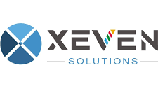

Hope to Skills
Lecture# 32
Irfan Malik, Dr. Sheraz Naseer

Slide 2
Agenda
LangChain
Chains
Retrieval Chains
QA Chains
QA with Source Document
Qdrant

Slide 3
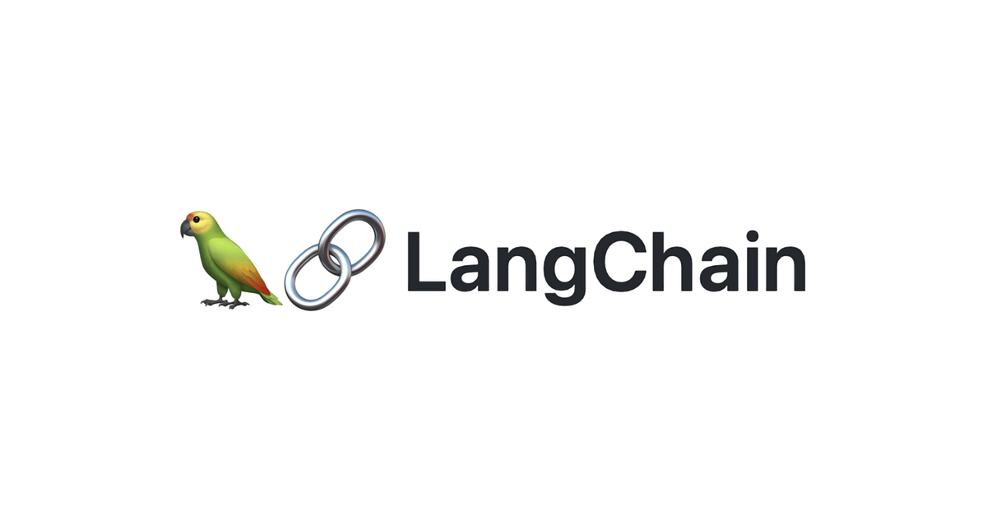
Lang Chain Introduction
Langchain is an open-source framework for building large language model (LLM) applications. It provides a set of tools and libraries that make it easy to develop and deploy LLM applications, such as chatbots, question answering systems, and text summarization tools.

Slide 4
What are Chains?
Chains are the core building block of Langchain applications.
A chain is a sequence of steps that are performed on a piece of text.
These steps can include:
Retrieval
Generation
Post-processing

Slide 5
What are Retrieval Chains?
Retrieval chains are chains that specifically focus on retrieving relevant documents from a corpus/data. This is useful for tasks such as question answering and document summarization.

Slide 6
What are QA Chains?
QA chains are specifically designed for question answering. They typically include a retrieval step to retrieve relevant documents from a corpus/data, as well as a generation step to generate an answer to the question using the retrieved documents.

Slide 7
QA with Source Document?
QA with Source Document chain is a specific type of QA chain that includes a step to return the source documents that were used to generate the answer. This is useful for tasks where the user needs to be able to verify the answer or learn more about the source of the information.

Slide 8

Qdrant Introduction
Qdrant is an open-source vector database that allows you to store, index, and search high-dimensional vectors at scale. It is a highly performant and scalable solution for vector search applications, such
Question answering
Recommendation systems
Natural language processing (NLP)

Slide 9
Benefits of using Qdrant
There are several benefits to using Qdrant for vector search applications:
Performance: It is highly performant, even for large datasets.
Scalability: It is scalable to handle large amounts of traffic and data.
Ease of use: It is easy to use and provides a simple API for storing, indexing, and searching vectors.
Free to use: It is free to use and modify.

Slide 10
Ready for Coding

